Slide 1
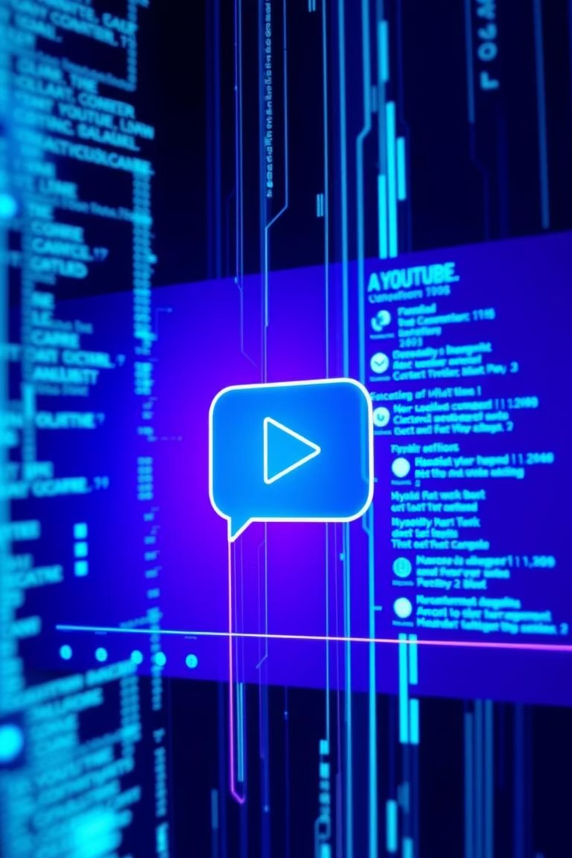
Multimodal AI Chatbot for YouTube Video QA
by Mercy Moparthy
Notes:
Good Morning, everyone! Welcome to My presentation on the development of a Retrieval Augmented Generation (RAG) AI chatbot which is designed to answer questions about specific YouTube videos.

Slide 2
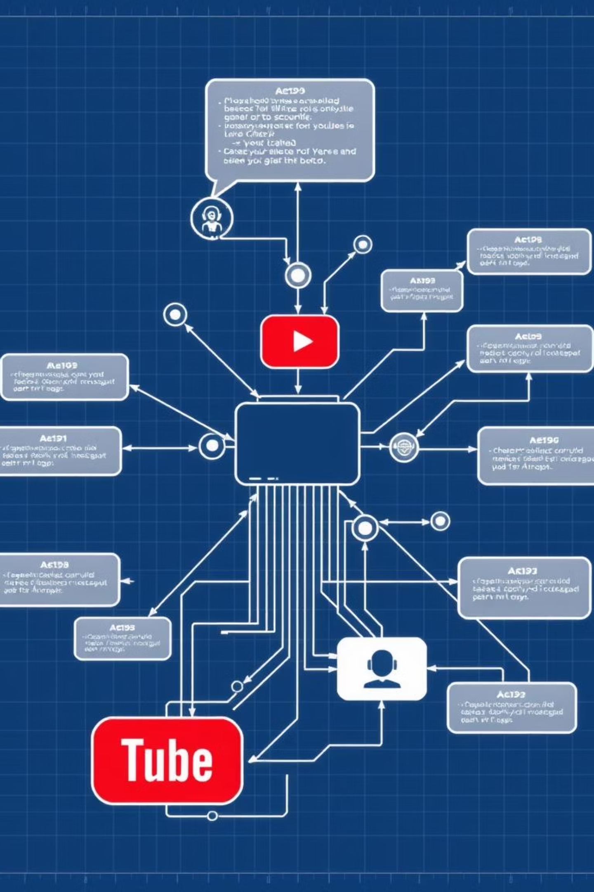
Project Planning & Scope Definition
Developing a RAG (Retrieval Augmented Generation) AI chatbot for YouTube videos, utilizing both audio and text data. This project aimed to explore practical RAG workflows, multimodal data, and deliver an end-to-end demo relevant to ServiceNow content.
Notes:
This project leverages both audio and text data, extracted directly from the videos, for accurate responses. Over the next few minutes, i’ll walk you through the architecture, and implementation of this solution
ServiceNow is a tool that companies use to streamline, track, and automate their business processes and services.

Slide 3







System Pipeline Architecture
Data Collection & Transcription
Audio extracted from YouTube videos, converted to text.
Data Preprocessing & Embedding
Text chunked, embedded, stored in vector database.
Query Processing & Retrieval
User questions processed, relevant text retrieved.
LLM Integration & Generation
Context and query fed to LLM for answers.
Answer Delivery
AI-generated answers presented to the user.
Notes:
The process begins with Data Collection & Transcription—here, we extract audio from YouTube videos and convert it into text.
Next, in Data Preprocessing & Embedding, the text is chunked, embedded, and stored in a vector database for efficient retrieval.
Moving to Query Processing & Retrieval, user questions are processed, and relevant text is retrieved from the database.
Then, in LLM Integration & Generation, the context and query are fed to a Large Language Model to generate accurate answers.
Finally, Answer Delivery presents these AI-generated answers to the user in a clear, concise manner.
This structured pipeline ensures our chatbot delivers precise, context-aware responses from YouTube video content.

Slide 4
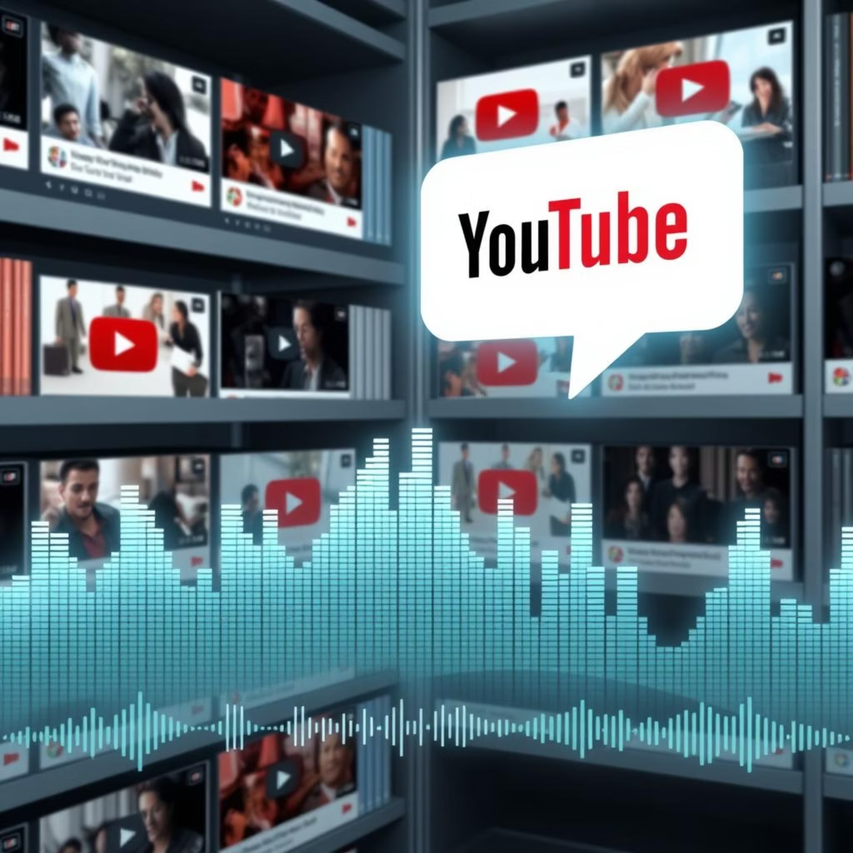
Data Ingestion & Transcription
Curated 22 relevant ServiceNow YouTube videos. Created detailed CSVs with metadata (titles, URLs, publish dates, duration) for content tracing.
Downloaded raw audio (MP3) from selected videos using `youtube-dl` to cloud storage for transcription.
Speech-to-Text (ASR)
Transcribed all audio files using OpenAI Whisper `large-v2`. Modularized transcription logic in a Jupyter notebook for scalable processing.
Metadata Management
Collected, cleaned, and organized video metadata (titles, durations, YouTube links, channel names). Ensured accurate linkage between metadata and transcribed text for efficient retrieval and UI features.
Notes:
I have downloaded 22 Youtube ServiceNow related Videos. I used yt_dlp tool for downloading metadata
ffmpeg as media processing tool added to the path which helps to process YouTube audio/video.
I started with Speech-to-Text using the OpenAI Whisper large-v2 model, which is known for its high accuracy in converting YouTube video audio into searchable text.
To manage this efficiently, I organized transcription tasks in a dedicated Jupyter notebook, enabling scalability for large datasets.
After that I focused on Metadata Management, collecting key details like Index, youtube link, subject, title, channel, description, length, publish_date, views.
This metadata was cleaned, standardized, and linked to transcripts, ensuring each segment ties back to its source video.

Slide 5
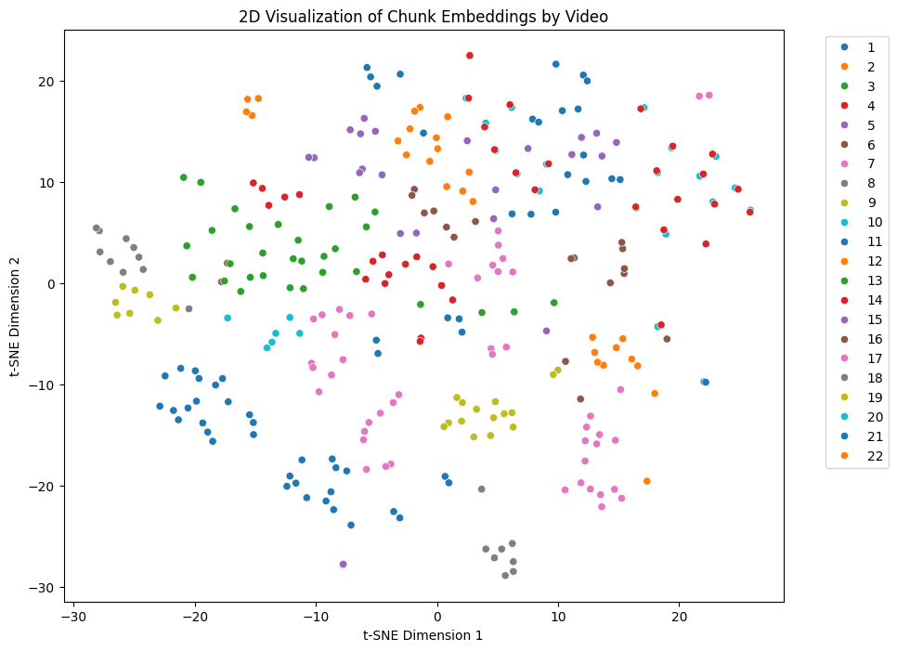

Index type: IndexFlatL2 for quick prototyping
Index type: IndexFlatL2
Index type: IndexFlatL2
Index type: IndexFlatL2
Data Preprocessing & Embedding
Text Chunking
Long transcripts were divided into smaller, semantically coherent chunks, ensuring manageable sizes for retrieval and LLM context.
Chunk size: 500 characters
Overlaps: 100 characters
Notes:
I have done tokenization and lemmatization on the metadata
Text chunking breaks long transcripts into smaller, manageable sections—typically 500–1000 characters per chunk but I choose 1000 characters per chunk—with 150-character overlaps to preserve key information.
As LangChain offers built-in tools and classes to handle chunking I used tools like LangChain’s RecursiveCharacterTextSplitter to automate this, linking each chunk to its video metadata, such as video id, chunk id, text, subject.
total 326 processed chunks after cleaning processed chunks by removing introductions
I used flags=re.IGNORECASE: to avoid case sensitive issues

Slide 6



Query Processing & Retrieval
Query Input & Embedding
Vectorization -FAISS
Retrival
User questions are transformed into vector embeddings for precise semantic search within the system.
Each text chunk was transformed into high-dimensional numerical embeddings using a robust language model, capturing semantic meaning.
Retrieved, relevant text chunks are compiled to provide detailed context for the large language model.
Query Embedding: all-MiniLM-L6-v2
Query embedding dimension: 768
FAISS: FAISS-CPU package
Index Type: IndexFlatl2
Retrieval top_k: 5 chunks per query
LangChain’s RetrievalQA
search_type="similarity",
search_kwargs={"k": 5}
Notes:
Query Input & Embedding
When i asks a question, the system first converts the question into a vector embedding.
This process transforms the text into a high-dimensional numeric format, capturing the meaning of the question for precise semantic search.
I used the all-MiniLM-L6-v2 model which is a Huggingface embedding model, producing vectors of size 768.
Vectorization - FAISS
On the document side, we break text into manageable chunks and embed each chunk using the same model.
Each chunk is transformed into a numerical embedding, capturing its semantic content.
These embeddings are stored in FAISS, a fast, efficient vector database that lets us do similarity searches.
I used the FAISS-CPU package and the IndexFlatL2 index type, which computes the L2 distance (or similarity) between vectors.
For each query, i retrieved the top 5 most similar chunks.
Retrieval
Finally, the retrieval step gathers the most relevant text chunks based on similarity to the query.
These retrieved chunks are passed to the LLM model to generate detailed, context-aware responses.
I used LangChain’s RetrievalQA module to handle this, specifying search_type="similarity" and customizing the number of results with search_kwargs={"k": 5}.
The RetrievalQA automatically tracked and provide a dashboard in LangSmith

Slide 7
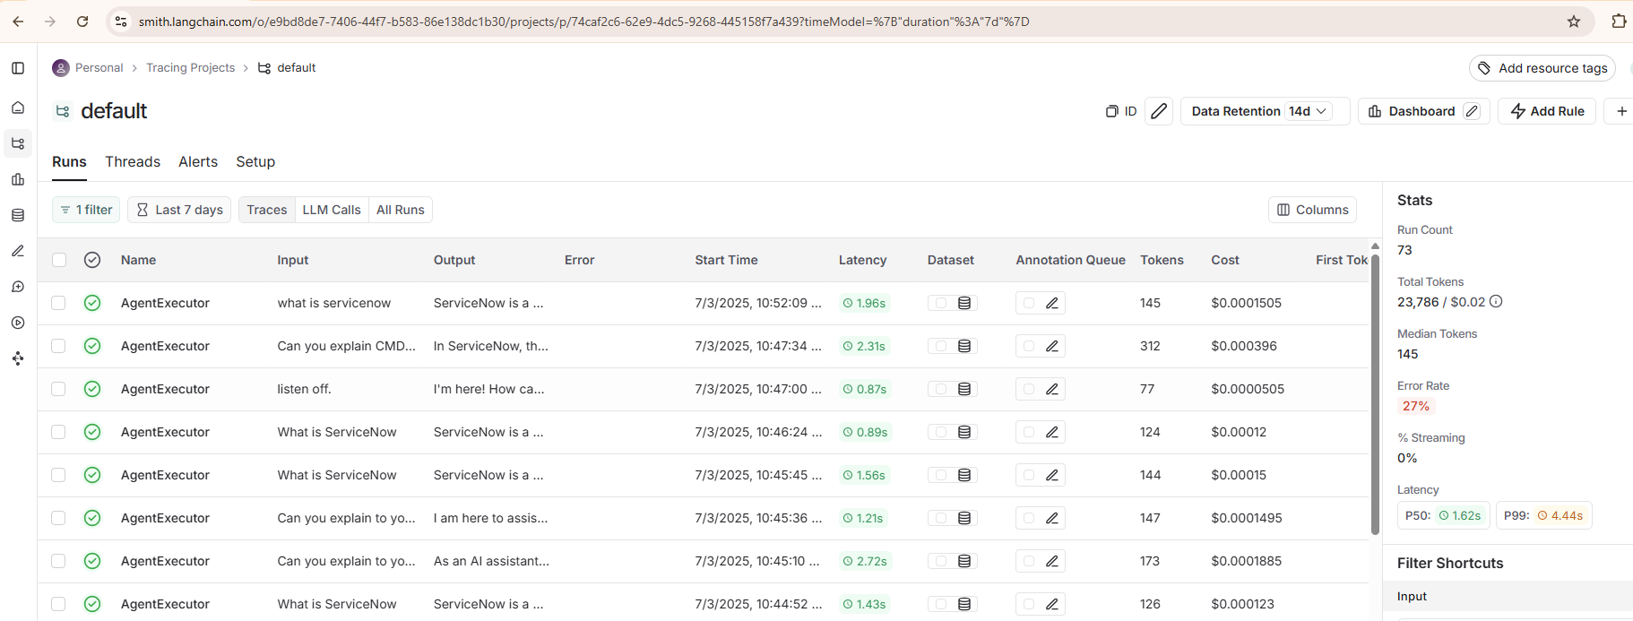
LangSmith Dashboard
Notes:
LangSmith is a cloud-based developer platform (from the creators of LangChain) that gives you a dashboard for debugging, tracing, and monitoring your LLM-powered applications.

Slide 8
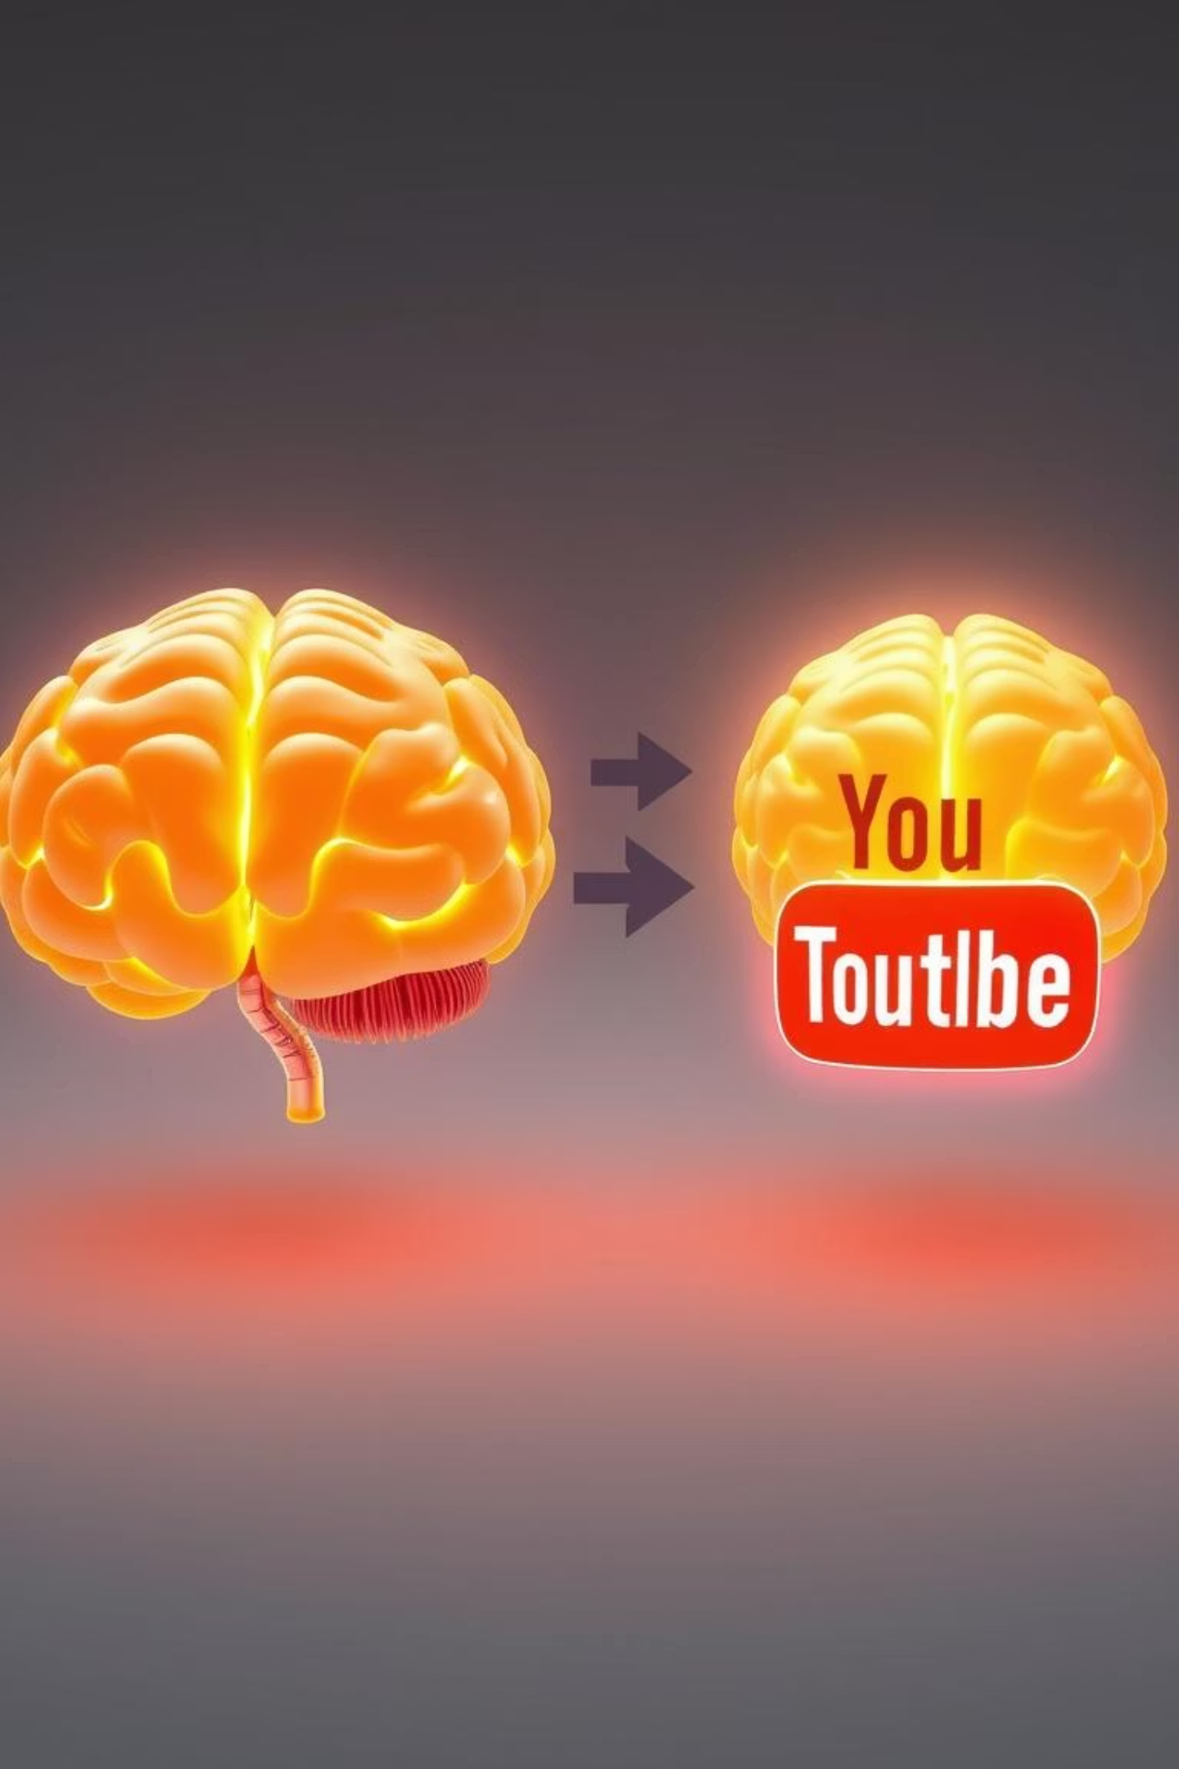


LLM Integration & Generation
Initial Plan: Llama-3-8B
Considered Llama-3-8B for its strong QA performance.
Intermediate Models:
Distilgpt2
Flan-t5-base
Flan-t5-large
Final Selection: Mistral-7B, Whisper
Switched to Mistral-7B & Whisper with and without Agents for its efficiency, lightweight nature, and excellent RAG results, making deployment easier.
Notes:
My initial plan considered Llama-3-8B for its strong question-answering performance, setting a solid foundation. However, I am unable to continue with this model due to system stats issue.
So, I tried exploring intermediate models: Distilgpt2, Flan-T5-base, and Flan-T5-large, evaluating their capabilities.
At the end, I continued with Mistral-7B and Whisper for the final selection, chosen for their efficiency, lightweight nature, and excellent RAG results, making deployment easier.
I Created Whisper Model with and without Agents to compare the Answers for the same queries and performance
Retrieval Agents (Retrieval-Augmented Agents) used in Whisper which gave more prompt answers as agents are “decision-makers” which can choose and orchestrate tools for flexible, dynamic responses.
And then Prompt Construction combines the user’s question, retrieved chunks, and instructions to ensure answers are based on transcript data.

Slide 9
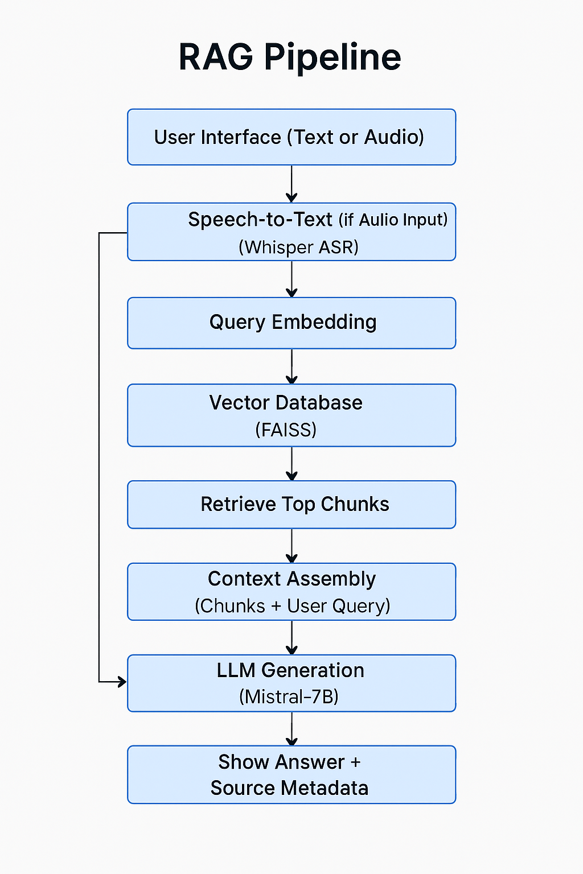
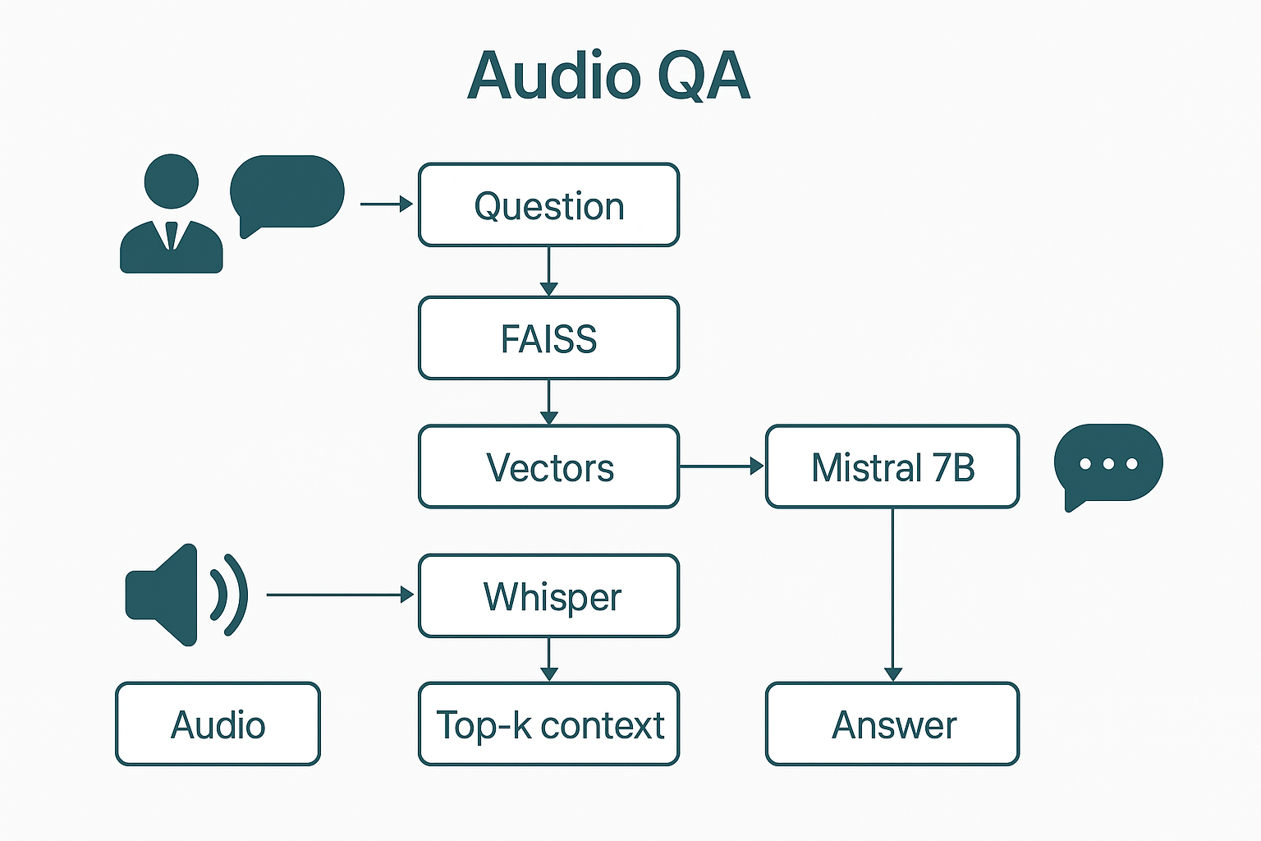
RAG Pipeline
Audio QA
Built a LangChain pipeline: query embedding, relevant chunk retrieval from vector DB, prompt construction, and Mistral-7B LLM answer generation grounded in video content.
Added support for user voice queries, converting spoken input to text via Whisper. This enhances user experience and showcases multimodal capability.
Notes:
RAG enables our chatbot to answer YouTube video questions using transcripts and metadata, starting with User Query Input via the Gradio interface, where audio is transcribed to text with OpenAI Whisper.
Next, Query Embedding converts the text into a numerical vector using a pre-trained model, capturing its meaning for semantic search.
In Retrieval from Vector Database, this embedding searches the FAISS database, retrieving the most relevant transcript chunks based on similarity.
Prompt Construction then combines these chunks with the original question to guide the LLM. LLM Generation uses Mistral-7B to process the prompt and generate an answer grounded in the context.
Finally, Answer Delivery displays the response in Gradio, optionally with metadata like video titles or timestamps for transparency.
This pipeline ensures relevance and accuracy by rooting answers in actual video content, with transparency via traceable transcript segments.
Project highlights include chunked transcripts for better retrieval, FAISS for efficient local search, LangChain for streamlined processes, Mistral-7B for strong performance, and modular Jupyter notebooks for scalability.

Slide 10
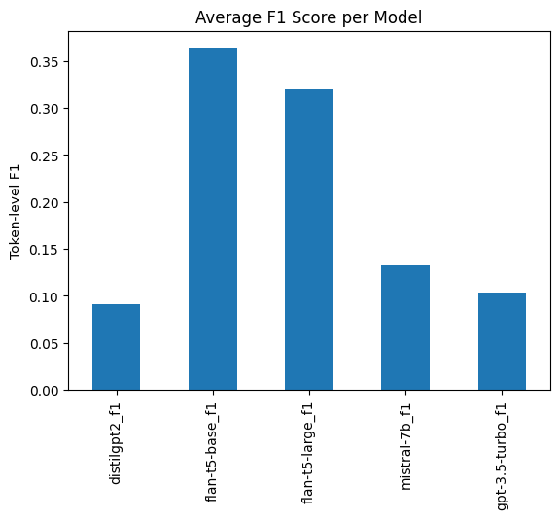
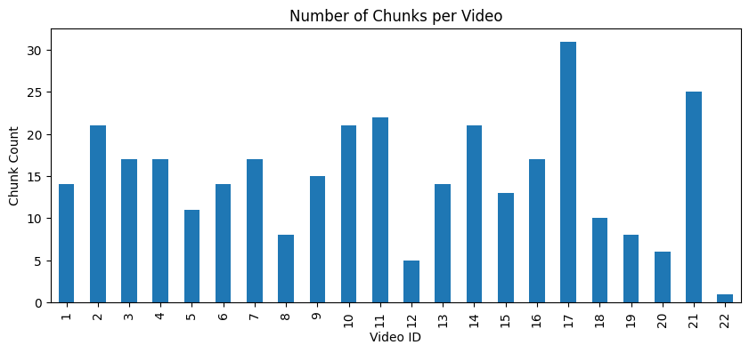
Evaluations & Metrics
No of Chunks per Video
F1 Score Per Model
Notes:
In this evaluation, although Flan-T5 models achieved higher F1 scores, manual inspection revealed that Mistral-7B’s answers were often more robust and contextually nuanced.
This highlights the importance of not relying solely on automated scoring metrics for open-ended question answering tasks.

Slide 11
RAG with Source Sample Output
? Question: How does ServiceNow use AI in incident management?
🧠 Answer: ServiceNow uses AI in incident management through their AI Ops solution, which utilizes machine learning and pattern recognition to assist and automate the work of IT operations. This helps move away from an incident creation culture to an alert-based, actionable mindset. The AI is built into the ServiceNow platform and is not acquired from other companies, making it a native and additive part of the platform's innovations and investments.
📚 Sources (with snippet preview):
1.📄 kQV6g8Vbbfc.txt 🔎 Snippet: Hello everyone, welcome to the KBDI podcast. We are bringing you a new set of topics and you will see a lot of focus on agentic AI starting this year. So as you probably know, ServiceNow is very deep into the three pillars that comes to workflow data fabric that combines all data from different disp...
2. 📄 KSWNDuKn9t0.txt 🔎 Snippet: Hi, this is Evans from the Technical Product and Solutions Marketing Team at ServiceNow. Today we're going to talk about ServiceNow IT Operations Management, specifically AI Ops and Event Management. AI Ops, or Artificial Intelligence for IT Operations, is the practice of using AI to assist and help...
3. 📄 WyQTP0AA1VU.txt 🔎 Snippet: Hi, this is Evans Nicholson from Technical Marketing at ServiceNow. Welcome to part two of the mini-series, AI-powered service operations starring ServiceNow, ITSM, and ITOM. At ServiceNow, we understand the amount of data coming in and the complexity of today's hybrid cloud environments. We know ma...
4. 📄 fqB-NcZmqXo.txt 🔎 Snippet: a couple of different things, which is very helpful. All right, awesome. Let's dive right in. It's a whole lot of talk about Agentec AI and its framework, but what does it look like in the context of ServiceNow platform? Yeah, so ServiceNow, we built our own Agentec AI framework on the Now platform....
Notes:
I used LangChain’s Document class to encapsulate chunks of transcript text along with their metadata (such as source filename), ensuring efficient organization and retrieval during the semantic search process.

Slide 12
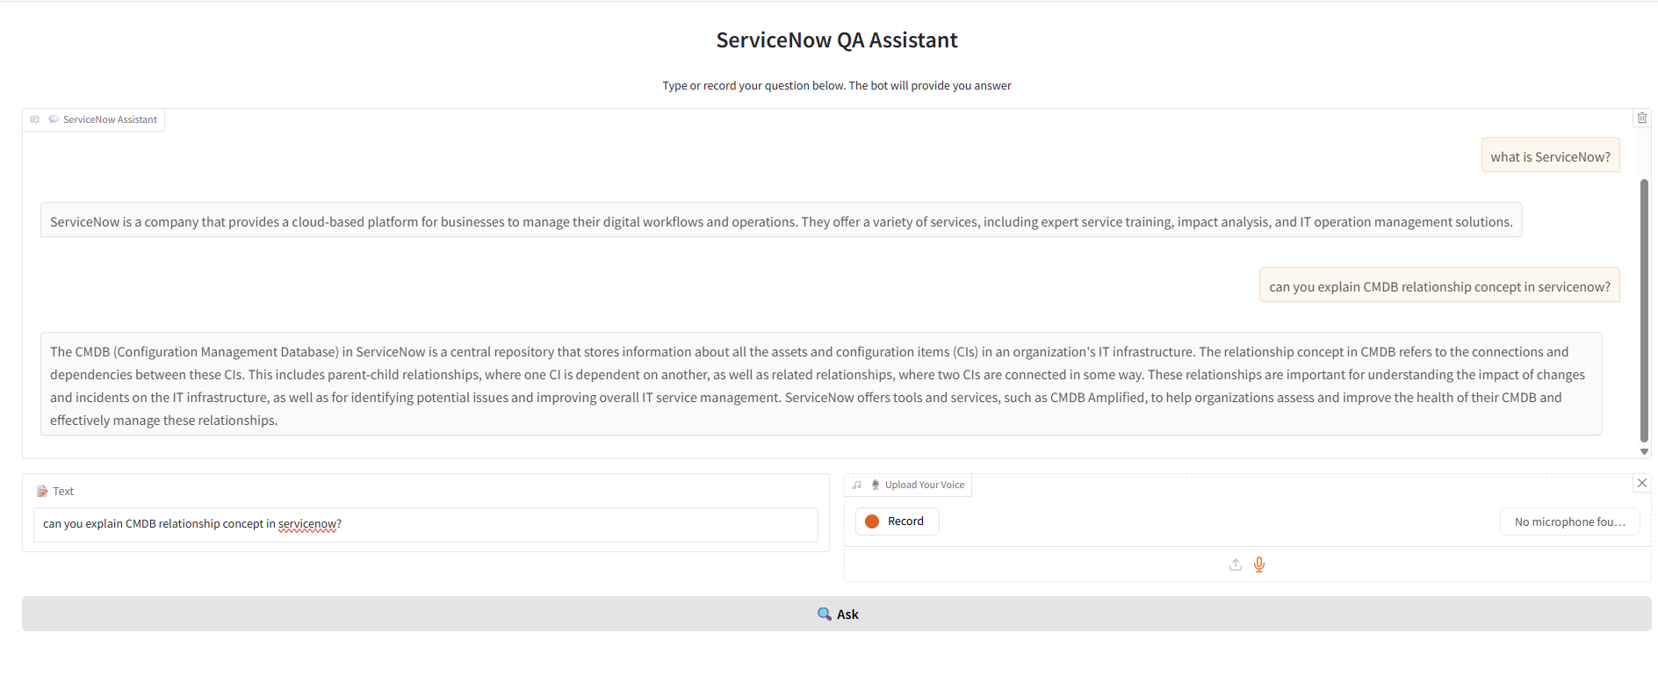
User Interface & Deployment
Tool: Gradio
Model: Whisper without Agent
LINK: https://cb8bf612db347d3711.gradio.live
Notes:
I used basic RetrievalQA chain

Slide 13
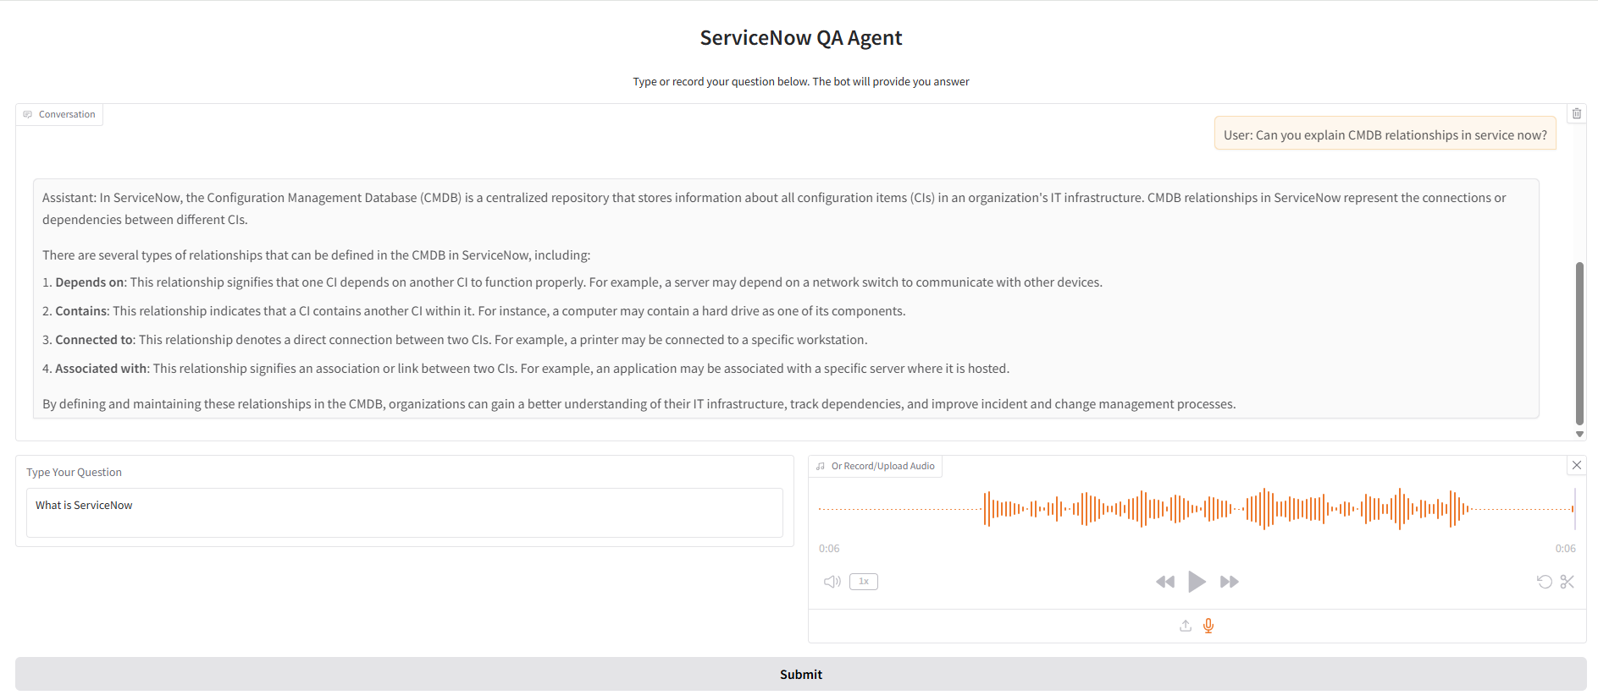
User Interface & Deployment
Tool: Gradio
Model: Whisper with Agent
LINK: https://8d2774a76fe4bfb5d8.gradio.live
Notes:
agents in LangChain dynamically plan how to answer based on the user’s input.
agents as “decision-makers” that can choose and orchestrate tools for flexible, dynamic responses.
In future versions, I will try add agents—components that decide how to handle each query, possibly combining multiple tools or steps for more complex tasks.

Slide 14
Thank You

